Slide 1
Blacktown Chinese Christian Church
Welcome to Our English Service 01.06.2025
English Service 9:45 – 11:00 am
Worship Songs: Passage: Speaker: Topic: Response Song: Announcements and Closing Prayer Benediction
Yet Not I But Through Christ In Me A thousand hallelujahs Who am I 1 Kings 3:5-15 Xavier Lakshmanan Solomon: TBA

Slide 2
BCCC english service

Slide 3

Please keep all phones on silent

Slide 4
Yet Not I But Through Christ In Me
CCLI Licence No: 5485849

Slide 5
What gift of grace is Jesus, my Redeemer
There is no more for heaven now to give
He is my joy, my righteousness and freedom
My steadfast love, my deep and boundless peace

Slide 6
To this I hold, my hope is only Jesus
For my life is wholly bound to His
Oh how strange and divine, I can sing "All is mine"
Yet not I, but through Christ in me

Slide 7
The night is dark but I am not forsaken
For by my side, the Savior He will stay
I labour on in weakness and rejoicing
For in my need, His power is displayed

Slide 8
To this I hold, my Shepherd will defend me
Through the deepest valley He will lead
Oh the night has been won and I shall overcome
Yet not I, but through Christ in me

Slide 9
No fate I dread, I know I am forgiven
The future sure, the price it has been paid
For Jesus bled and suffered for my pardon
And He was raised to overthrow the grave

Slide 10
To this I hold, my sin has been defeated
Jesus now and ever is my plea
All the chains are released, I can sing "I am free"
Yet not I, but through Christ in me

Slide 11
With every breath, I long to follow Jesus
For He has said that He will bring me home
And day by day, I know He will renew me
Until I stand with joy before the throne

Slide 12
To this I hold, my hope is only Jesus
All the glory evermore to Him
When the race is complete, still my lips shall repeat
"Yet not I, but through Christ in me"

Slide 13
When the race is complete, still my lips shall repeat
"Yet not I, but through Christ in me"
"Yet not I, but through Christ in me"
"Yet not I, but through Christ in me"

Slide 14
A Thousand Hallelujahs
CCLI Licence No: 5485849

Slide 15
Who else would rocks cry out to worship?
Whose glory taught the stars to shine?
Perhaps creation longs to have the words to sing
But this joy is mine

Slide 16
With a thousand hallelujahs
We magnify Your name
You alone deserve the glory
The honor and the praise

Slide 17
Lord Jesus
This song is forever Yours
A thousand hallelujahs
And a thousand more

Slide 18
Who else would die for our redemption?
Whose resurrection means I’ll rise?
There isn’t time enough to sing of all You’ve done
But I have eternity to try

Slide 19
With a thousand hallelujahs
We magnify Your name
You alone deserve the glory
The honor and the praise

Slide 20
Lord Jesus
This song is forever Yours
A thousand hallelujahs
And a thousand more

Slide 21
Praise to the Lord
To the lamb
To the King of Heaven

Slide 22
Praise for He rose
Now He reigns
We will sing forever

Slide 23
Praise to the Lord
To the lamb
To the King of Heaven

Slide 24
Praise for He rose
Now He reigns
We will sing forever

Slide 25
With a thousand hallelujahs
We magnify Your name
You alone deserve the glory
The honor and the praise

Slide 26
Lord Jesus
This song is forever Yours
A thousand hallelujahs
And a thousand more

Slide 27
Praise to the Lord
To the lamb
To the King of Heaven

Slide 28
Praise for He rose
Now He reigns
We will sing forever

Slide 29
With a thousand hallelujahs
We magnify Your name
You alone deserve the glory
The honor and the praise

Slide 30
Lord Jesus
This song is forever Yours
A thousand hallelujahs
And a thousand more

Slide 31
Who Am I
CCLI Licence No: 5485849

Slide 32
Who am I, that the Lord of all the earth
Would care to know my name
Would care to feel my hurt?

Slide 33
Who am I, that the Bright and Morning Star
Would choose to light the way
For my ever wandering heart?

Slide 34
Not because of who I am
But because of what You've done
Not because of what I've done
But because of who You are

Slide 35
I am a flower quickly fading
Here today and gone tomorrow
A wave tossed in the ocean
A vapor in the wind

Slide 36
Still, You hear me when I'm calling
Lord, You catch me when I'm falling
And You've told me who I am
I am Yours, I am Yours

Slide 37
Who am I, that the eyes that see my sin
Would look on me with love
And watch me rise again?

Slide 38
Who am I, that the voice that calmed the sea
Would call out through the rain
And calm the storm in me?

Slide 39
Not because of who I am
But because of what You've done
Not because of what I've done
But because of who You are

Slide 40
I am a flower quickly fading
Here today and gone tomorrow
A wave tossed in the ocean
A vapor in the wind

Slide 41
Still, You hear me when I'm calling
Lord, You catch me when I'm falling
And You've told me who I am
I am Yours

Slide 42
Not because of who I am
But because of what You've done
Not because of what I've done
But because of who You are

Slide 43
I am a flower quickly fading
Here today and gone tomorrow
A wave tossed in the ocean
A vapor in the wind

Slide 44
Still, You hear me when I'm calling
Lord, You catch me when I'm falling
You told me who I am
I am Yours, I am Yours, I am Yours

Slide 45
Whom shall I fear? Whom shall I fear?
'Cause I am Yours, I am Yours

Slide 46
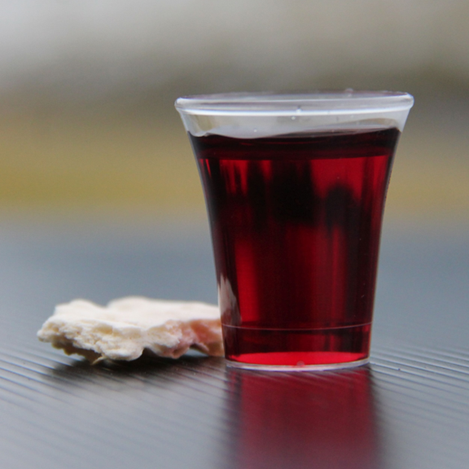
Holy Communion

Slide 47
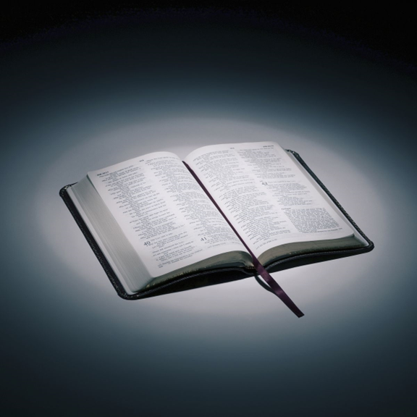
Bible reading

Slide 48
1 Kings 3:5-15
⁵ At Gibeon the Lord appeared to Solomon during the night in a dream, and God said, “Ask for whatever you want me to give you.”
⁶ Solomon answered, “You have shown great kindness to your servant, my father David, because he was faithful to you and righteous and upright in heart. You have continued this great kindness to him and have given him a son to sit on his throne this very day.

Slide 49
1 Kings 3:5-15
⁷ “Now, Lord my God, you have made your servant king in place of my father David. But I am only a little child and do not know how to carry out my duties. ⁸ Your servant is here among the people you have chosen, a great people, too numerous to count or number.

Slide 50
1 Kings 3:5-15
⁹ So give your servant a discerning heart to govern your people and to distinguish between right and wrong. For who is able to govern this great people of yours?”
¹⁰ The Lord was pleased that Solomon had asked for this.

Slide 51
1 Kings 3:5-15
¹¹ So God said to him, “Since you have asked for this and not for long life or wealth for yourself, nor have asked for the death of your enemies but for discernment in administering justice, ¹² I will do what you have asked. I will give you a wise and discerning heart, so that there will never have been anyone like you, nor will there ever be.

Slide 52
1 Kings 3:5-15
¹³ Moreover, I will give you what you have not asked for—both wealth and honor—so that in your lifetime you will have no equal among kings. ¹⁴ And if you walk in obedience to me and keep my decrees and commands as David your father did, I will give you a long life.”

Slide 53
1 Kings 3:5-15
¹⁵ Then Solomon awoke—and he realized it had been a dream.
He returned to Jerusalem, stood before the ark of the Lord’s covenant and sacrificed burnt offerings and fellowship offerings. Then he gave a feast for all his court.

Slide 54
Announcements

Slide 55





Account name: Blacktown Chinese Christian Church
Account number: 4216 50263
Offering
BSB: 112 - 879
Please put in "offering" as the reference
The offering box is available at the back of the hall

Slide 56
Prayer points

Slide 57
Mingle time!

